Slide 1

Fuzzy Control System

Slide 2
Group Members:
Muhammad Taqui 021
Babar Ali 051
Zain ul Abadeen 029
Usman Iftikhar 022

Slide 3

Introduction:
This report presents the design and implementation of a fuzzy control system for managing a greenhouse environment. The system is designed to maintain optimal temperature and humidity levels, considering fluctuations in ambient temperature, sunlight intensity, and humidity levels.

Slide 4
Complexity and Uncertainty
Factors:
Ambient Temperature: Variations impact internal climate.
Sunlight Intensity: Changes daily/seasonally; affects temperature and photosynthesis.
Humidity Levels: Fluctuates with weather and watering; crucial for plant health.
Challenges:
Interdependencies: Adjusting one factor affects others; requires balanced control.
Non-linear Behavior: Small changes can have large, unpredictable effects.
Measurement Uncertainty: Sensor errors and environmental noise complicate control.

Slide 5
Fuzzy Logic Solution
Qualitative Handling: Manages qualitative inputs (e.g., "high temperature").
1
Rule-based System: Applies fuzzy rules to manage interactions and uncertainty.
2

Slide 6
Inputs and Outputs
Inputs:
Ambient Temperature: Measures the external temperature impacting the greenhouse.
Sunlight Intensity: Assesses the level of sunlight affecting internal climate.
Ambient Humidity: Gauges the moisture level in the air inside the greenhouse.
Outputs:
Heater Control: Adjusts the heater to maintain optimal temperature.
Humidifier Control: Modulates the humidifier to keep humidity at desired levels.

Slide 7
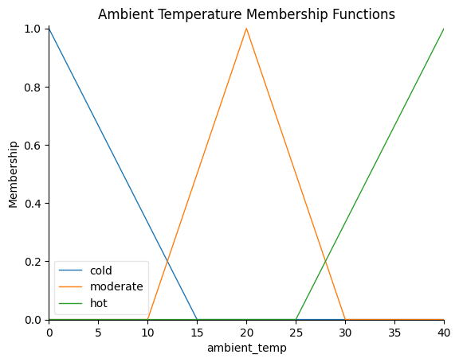
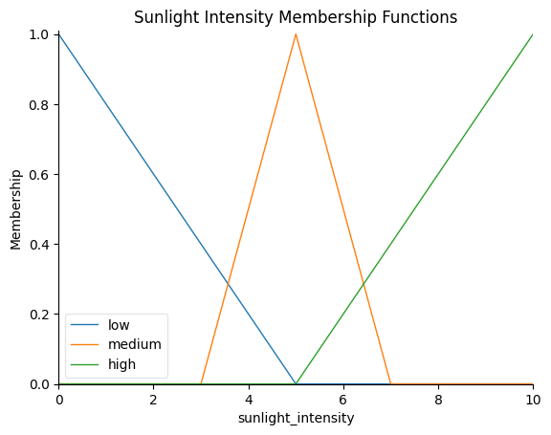
Membership Functions

Slide 8
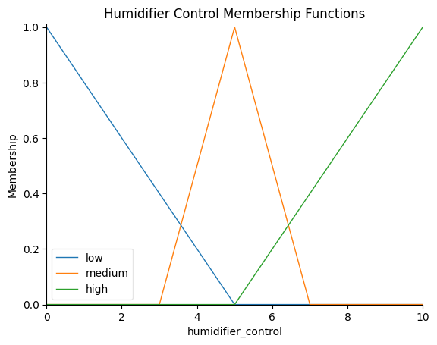
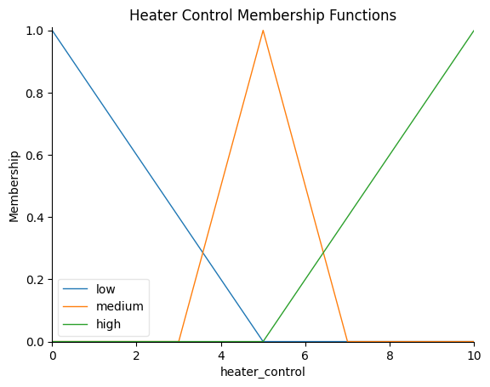

Slide 10
Fuzzy Rules
If the ambient temperature is cold and the sunlight intensity is low, then:
Heater Control: High
Humidifier Control: Medium
If the ambient temperature is moderate and the humidity level is comfortable, then:
Heater Control: Low
Humidifier Control: Low
If the ambient temperature is hot and the humidity level is humid, then:
Heater Control: Low
Humidifier Control: High
If the ambient temperature is cold and the humidity level is dry, then:
Heater Control: High
Humidifier Control: High

Slide 11
Fuzzy Rules
If the ambient temperature is hot and the sunlight intensity is high, then:
Heater Control: Low
Humidifier Control: Low
If the ambient temperature is moderate and the sunlight intensity is low, then:
Heater Control: Medium
Humidifier Control: High
If the ambient temperature is moderate and the sunlight intensity is high, then:
Heater Control: Low
Humidifier Control: Medium
If the ambient temperature is cold and the sunlight intensity is high, then:
Heater Control: Medium
Humidifier Control: Low

Slide 12
Fuzzy Rules
If the ambient temperature is hot and the sunlight intensity is low, then:
Heater Control: Medium
Humidifier Control: High
If the ambient temperature is moderate and the humidity level is dry, then:
Heater Control: High
Humidifier Control: Medium

Slide 13
Fuzzy Inference Engine
Mamdani inference method is used.
It applies fuzzy rules to the inputs to generate outputs.

Slide 14
Defuzzification
Defuzzification is the process of converting fuzzy outputs to crisp values.
The Centroid method is used to achieve this.

Slide 15
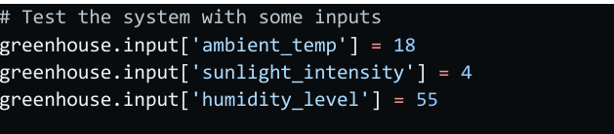
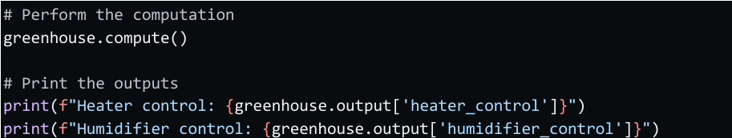
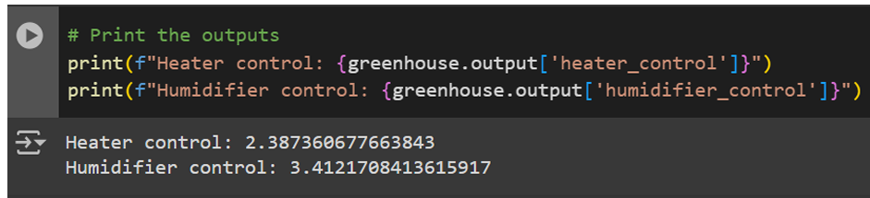
Implementation and Results
Implementation in Python using the scikit-fuzzy library.

